Slide 1
7TH GRADE EXPECTATIONS

Slide 2
7TH GRADE EXPECTATIONS
Welcome to the 7th Grade!
We are excited to have you on this hallway, and it is our goal everyday to work as hard as we can for you so that you ultimately will be able to reach the goals you have set for yourself!
In order for you to have a successful school year there are a few things we need to go over with you!
Make sure you pay close attention so that you can have THE BEST possible 7th grade year!

Slide 3
Morning Homeroom Expectations
*You may go to your locker and use the bathroom until 8:05. Make sure to take the classroom bathroom pass to the restrooms.
*Use the rest of homeroom time to work on any school work, read, organize your backpack/binders, sharpen pencils, or check-out a book from the Media Center (take a Media Pass). You cannot hang out in the hallway or visit other classrooms.
*At 8:05 we will watch announcements, say the pledge, and then you will go to Electives.

Slide 4
WHEN TO TALK/NOT TALK in the Hallway

Slide 5
WHEN TO TALK/NOT TALK in the Hallway
Make Sure You Follow These Simple Directions
When you are in the seventh grade hall YOU ARE allowed to talk (Screaming is not allowed, but a regular talking voice is acceptable).
As soon as you leave our hallway (Past the double doors) while headed to enhancements YOU ARE NOT allowed to talk.
If you are caught talking by a teacher you will be given a “You Got Caught Talking Card”.
You are not allowed to “hang out” in the hallways while going to lockers. Get your stuff and go to class.

Slide 6
WHEN TO TALK/NOT TALK in the Hallway
How does a “You Got Caught Talking” card work?
It’s simple, if you are caught talking you will be given the card. Then you will have to go to Mr. Waller, who will be by the double doors at the entrance way of the 7th grade hallway.
Mr. Waller will write your name down on a checklist, and if you have your name written down TWO TIMES in a given week you will serve silent lunch.

Slide 7
WHEN TO TALK/NOT TALK in the Hallway
The same applies coming back from enhancements.
You ARE NOT allowed to talk until you are back on the 7th grade hallway (Past the double doors).
If you are caught talking you will be given a You Got Caught talking card and will have to go to Ms. Birkhead who will write your name down on a checklist.
Remember if you get two cards in a week you will have……..

Slide 8
MOVEMENT IN HALLWAY EXPECTATION
Remember when you are moving throughout the school with your class you are always to be on the 3rd block and Silent!
Examples are walking as a class to the Media Center or to lunch.

Slide 9
BATHROOM USAGE

Slide 10
BATHROOM USAGE
These are the times you are allowed to use the bathroom
During homeroom (when you arrive at school until 8:05 am). You must take the classroom bathroom pass.
When you go to lunch with 5th/6th block (either before or after lunch depends on your teacher).
At the end of the day during your AIR TIME class. You must take the classroom bathroom pass.
You also will be given an “emergency pass”.
You will leave your cell phone in the classroom before going to the bathroom.

Slide 11
BATHROOM USAGE
You will be given 9 Emergency Passes for each Quarter.
You can use these 9 emergency passes to go to the bathroom, your locker, or to get water.
Remember you only have 9 per nine weeks. If you use all of your emergency passes before the end of the nine weeks, you will not be able to leave the classroom to go to your locker, bathroom, or to get water until a new pass is given out the following nine weeks.
**You still can use the bathroom during Homeroom, Lunch, and AirTime each day with your class.

Slide 12
BATHROOM USAGE
Per our 7th grade Administrator Ms. Williams, if you RUN OUT of emergency passes for a given nine weeks YOU WILL NOT be able to leave during class to use the bathroom/or any other reason.
No playing around,
horseplaying, throwing
water, throwing paper
towels, etc… in the
bathroom!! Doing so will
result in an Office Referral!

Slide 13
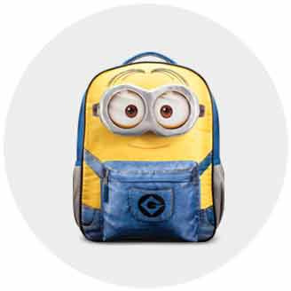
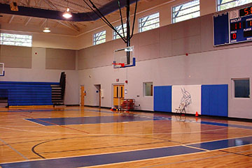
Backpacks, Cell Phones, Gum and Electives

Slide 14
Backpacks, Cell Phones, Gum and Electives
All students must leave their backpacks in their homeroom before going to Electives. Your Cell Phone must also be left in your backpack.
If you have Gym you may bring a gym bag with your dress out clothes.
For other electives, hand carry whatever notebook/binder and pencil you use for your electives.
Teachers will keep their doors locked during Electives so your things will be safe.
No Gum is allowed in any of your classes.

Slide 15
Cell Phone Policy
Your cell phone must stay in your backpack and put away at all times during the school day. The school day begins when you step inside the building and ends when you step outside the building.
This includes the hallways, the bathrooms, and all classrooms.
The only exception is if your teacher gives you permission for educational use in a class.

Slide 16
Cell Phone Policy
1st offense: your teacher will remind you to put the cell phone away.
2nd offense: you will be sent to the office with your phone and it will be kept in a safe place until the end of the day. Your parent will be contacted and he or she may pick up your phone from the office.
3rd Offense: you will once again take your phone to the office for safekeeping and you will receive a Choices Referral for failure to follow a lawful directive from your teacher. Your parent will be contacted and he or she may pick up your phone from the office.

Slide 17
Cell Phone Policy
*Students may not video, record, or take a picture of any teacher, staff member, or another student while at school per Johnston County Schools Policy, without that person’s written permission.
*This will result in an immediate Office Referral on the first offense and your phone will be kept in the office until a parent is able to pick it up.
*It simply is not worth it!! Keep phones put away during school!!!

Slide 18
Gum Policy
No Gum is allowed in any class.
1st offense: you will be asked to spit it out.
2nd offense: you will be referred to Choices for failure to follow a lawful directive by a teacher.
Frankly, there are many students who
leave chewed gum on the floor or stick it
onto furniture. This is the reason for the
No Gum Policy.

Slide 19
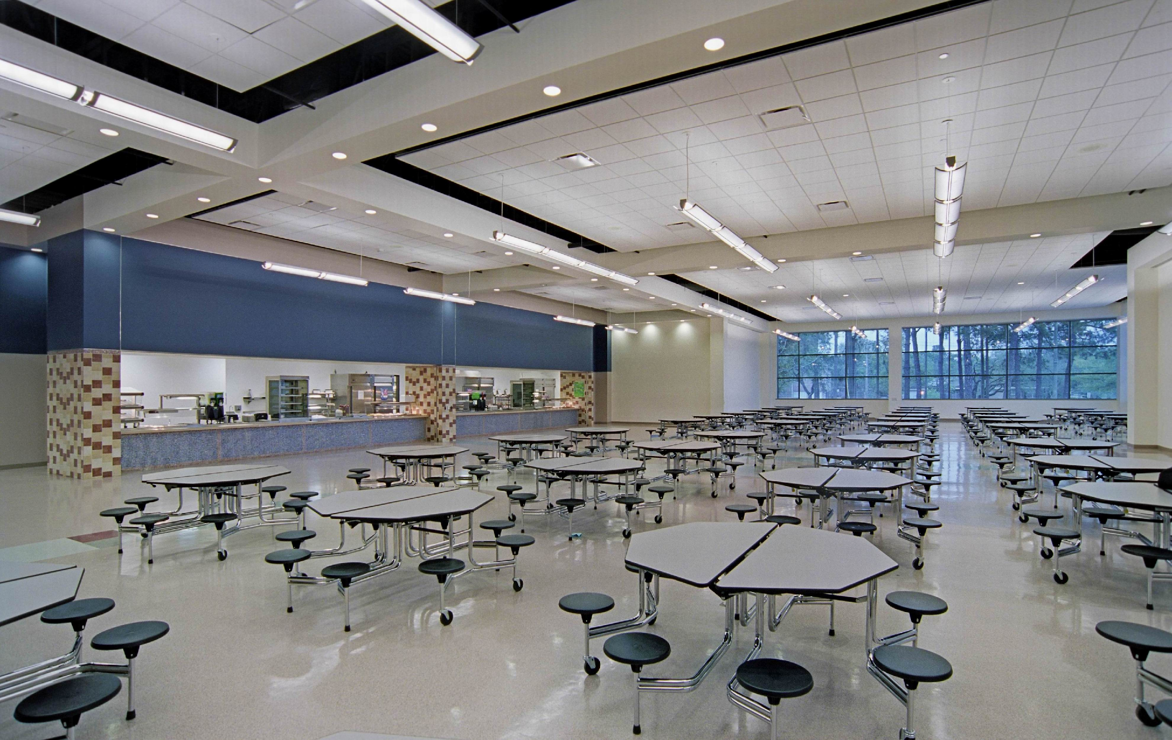
CAFETERIA EXPECTATIONS

Slide 20
CAFETERIA EXPECTATIONS
Once you get your food from the cafeteria line YOU ARE NOT ALLOWED to get back up.
This means you must get ALL of your food/drinks/utensils when you go through the line.
You are NOT allowed to go to the restroom while in the cafeteria (no adults to monitor bathrooms).
If you have silent lunch you are to sit at the tables closest to the stage.
You are not allowed to talk during silent lunch, if you are caught talking/communicating in any manner with someone you will receive another day of silent lunch (IT ISN’T WORTH IT).

Slide 21
FIRE DRILL/CODE 300 EXPECTATIONS
When we have a fire drill you are to immediately get into a line QUIETLY and follow your teacher outside of school in an orderly QUIET manner.
When there is a code 300 drill you are to go to the part of the classroom your teacher directs you QUIETLY.
You are not allowed to talk until the code 300 drill is over.
If you happen to be in the hallway when there is a code 300 drill you are to go to the nearest classroom if you can not get back to your classroom in a quick manner.

Slide 22
Walkers, Bus Riders, and Car Pool
Bus Riders are dismissed first, at the 3:10 bell.
Carpool students are dismissed next, at the 3:13 bell. You must walk to the front of the school and exit through the Front Door. You may not exit through the Back Door.
Walkers must have turned in the Green Permission Form before you will be allowed to walk home. Walkers must exit through the end door at the 3:13 bell.
Walkers can not loiter (hang-out) outside of the end door. You must keep on walking to your home.

Slide 23
7TH GRADE EXPECTATIONS
If you remember these simple rules you will have a successful experience on the 7th grade hall!

